Slide 1
The Communication Process
Sender
Receiver
Message to be sent
Encoded message
Channel
Message received
Message decoded
NOISE
Feedback

Slide 2
Wheel
All Channel
Chain

Slide 3
Small Group Networks and Effective Criteria
 |  | Networks
Criteria | Chain | Wheel | All Channel
Speed | Moderate | Fast | Fast
Accuracy | High | High | Moderate
Emergence of Leader | Moderate | High | None
Member Satisfaction | Moderate | Low | High

Slide 4
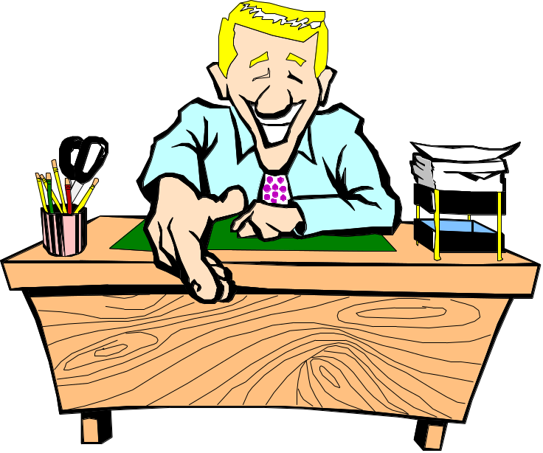
Upward Communication
Serial communication
Attitude surveys
Focus groups
Exit interviews
Suggestion boxes
Third party facilitators

Slide 5

Downward Communication
Bulletin boards
Policy manuals
Newsletters
Intranets

Slide 6

Business Communication
Memos
Telephone calls
Email (and IM, TM, Blogs)
Voice mail
Face-to-face meetings
Committee meetings
Videoconferencing

Slide 7
Information Richness of Communication Channels
Prerecorded speeches
Live speeches
Formal reports, bulletins
Online Discussion Groups
Video conferences
High Channel Richness
Low Channel Richness
Memos, letters
Voice mail
Face-to-face conversations
Electronic mail
Telephone conversations

Slide 8
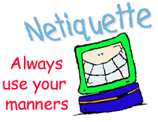

Email Etiquette and
Voice Mail Etiquette
Notes:
)

Slide 9
Interpersonal Communication
Three problem areas:
  Intended message versus message sent
  Message sent versus message received
  Message received versus message interpreted

Slide 10
Sender
Receiver
Encodes
Message
Sends
Message
Receives
Message
Decodes
Message
What I want
to say
What I say
I hear
her say
I think
she means

Slide 11
Gender Differences in Communication
(Tannen, 1986 & 1990)
Men
  Talk about major events
  Tell the main point
  Are more direct
  Use “uh-huh” to agree
  Are comfortable with silence
  Concentrate on the words spoken
  Sidetrack unpleasant topics
Women
  Talk about daily life
  Provide details
  Are more indirect
  Use “uh-huh” to listen
  Are less comfortable with silence
  Concentrate on nonverbal cues and paralanguage
  Focus on unpleasant topics

Slide 12
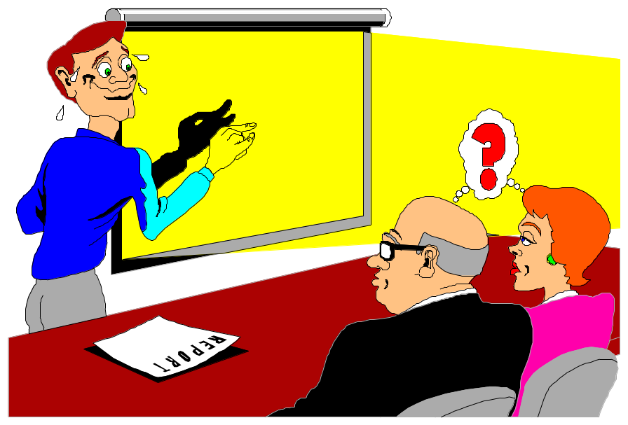
Noise

Slide 13
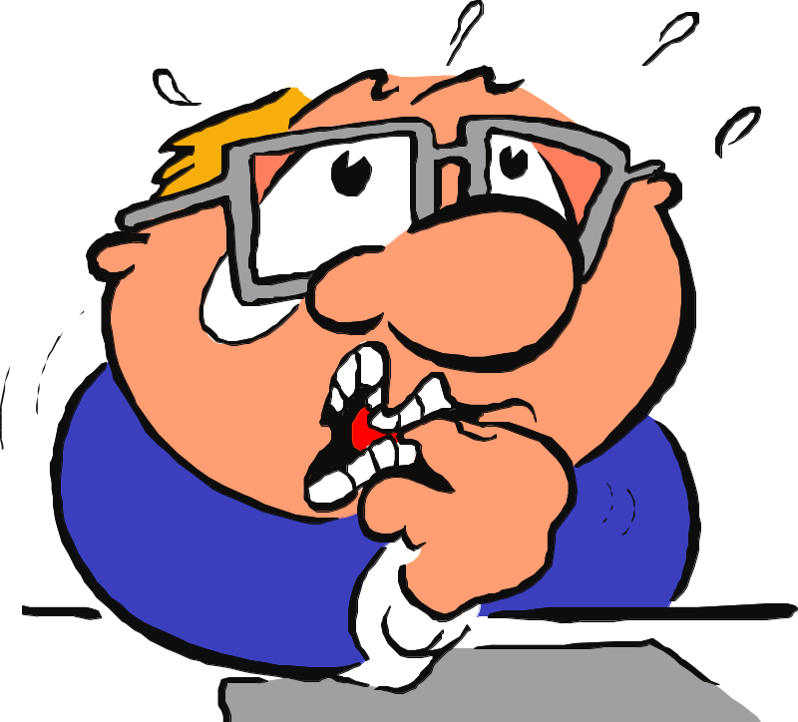
Nonverbal Cues

Slide 14
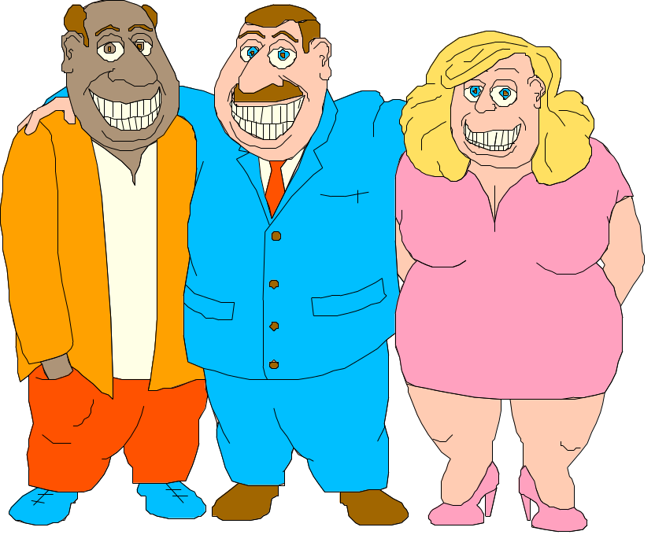
Use of Space
Intimacy zone
Personal distance zone
Social distance zone
Public distance zone

Slide 15
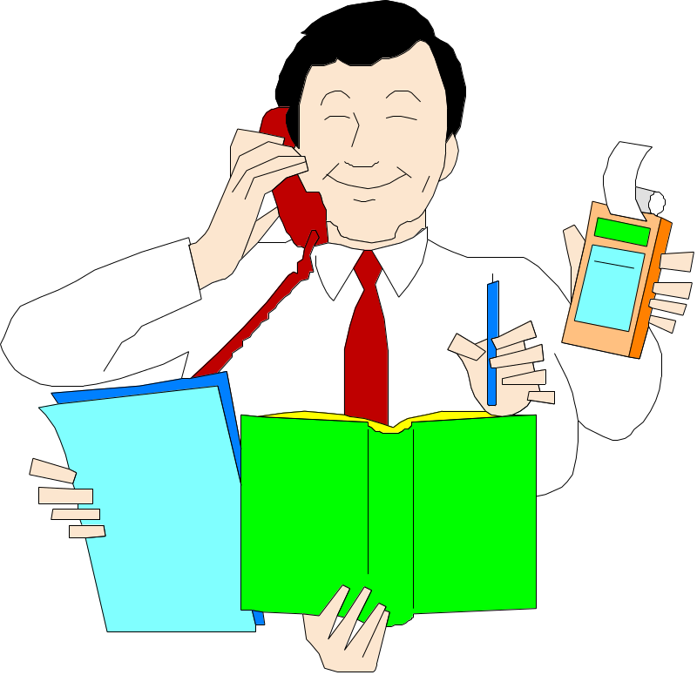
Use of Time

Slide 16
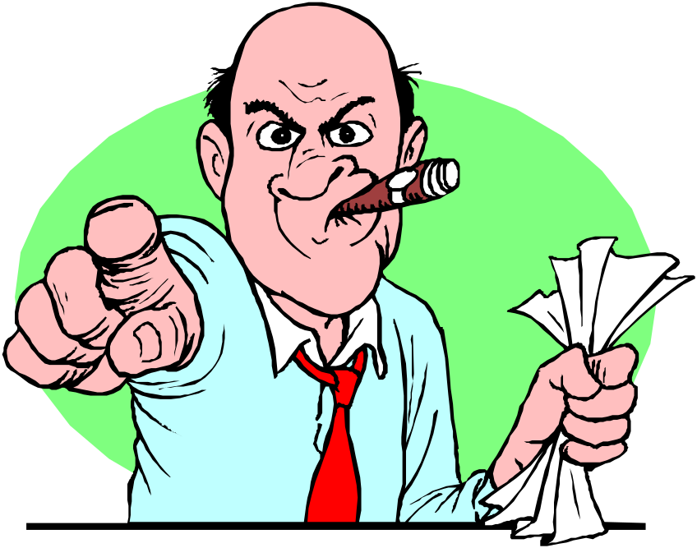
Paralanguage

Slide 17
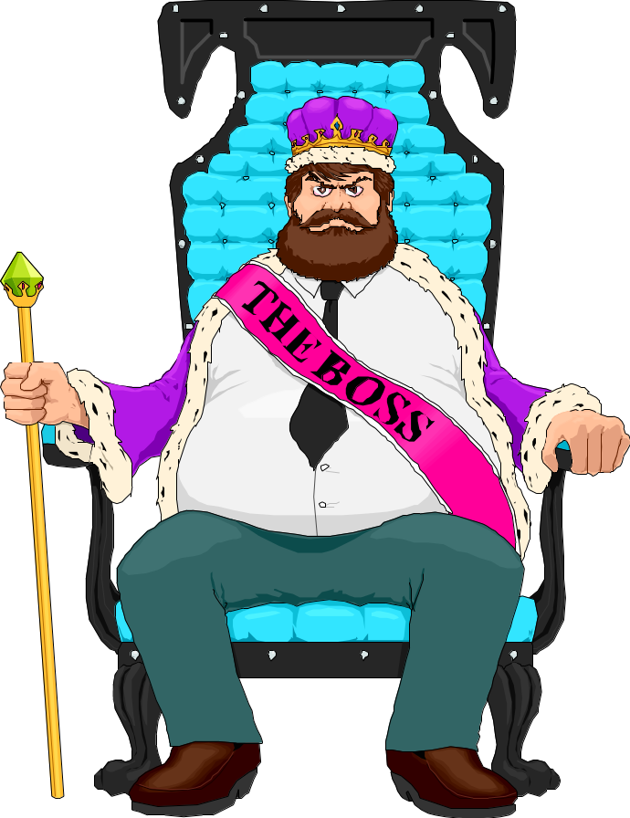
Artifacts
Our office
What we wear
The car we drive
The house we live in

Slide 18
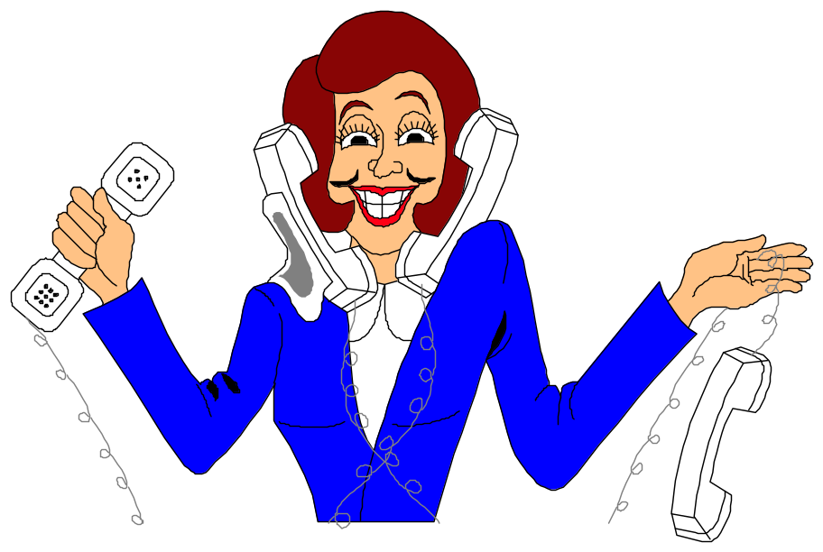
When we have too much information, we tend to:
Assimilate
Sharpen
Level

Slide 19
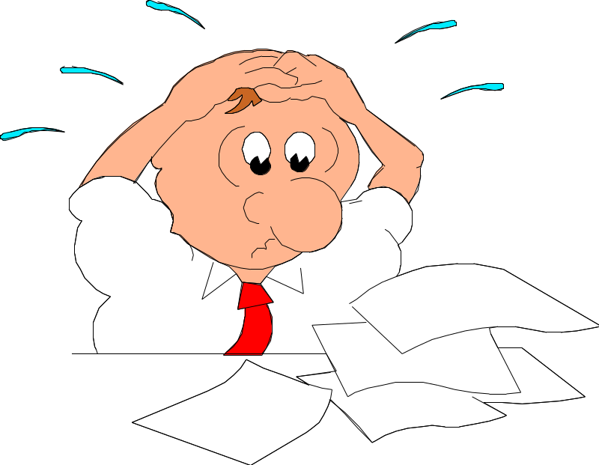
Reactions to Information Overload
Omission
Error
Queuing
Escape
Use of a gatekeeper
Use of multiple channels

Slide 20
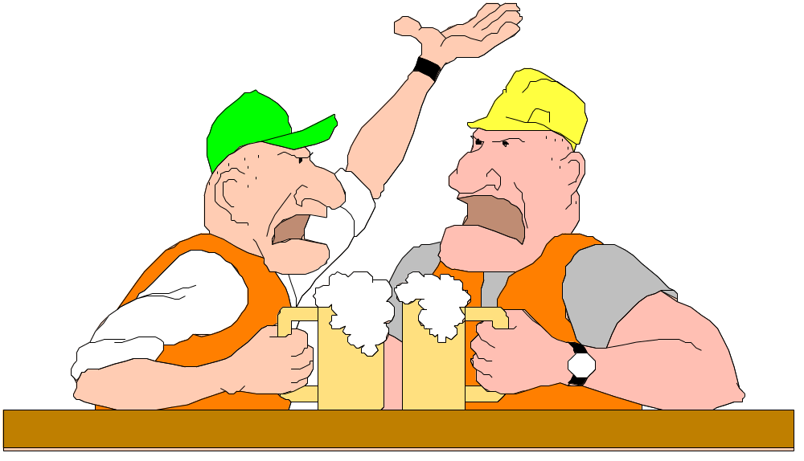
Listening Styles
(Geier & Downey, 1980)
Leisure
Inclusive
Stylistic
Technical
Empathic
Nonconforming

Slide 21
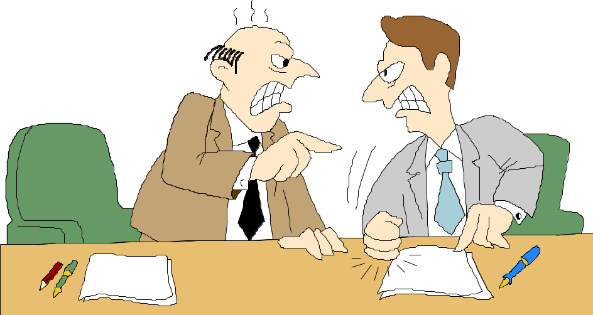
Other Factors
Emotional State
Bias
Cognitive Ability
Drugs and Alcohol

